Slide 1
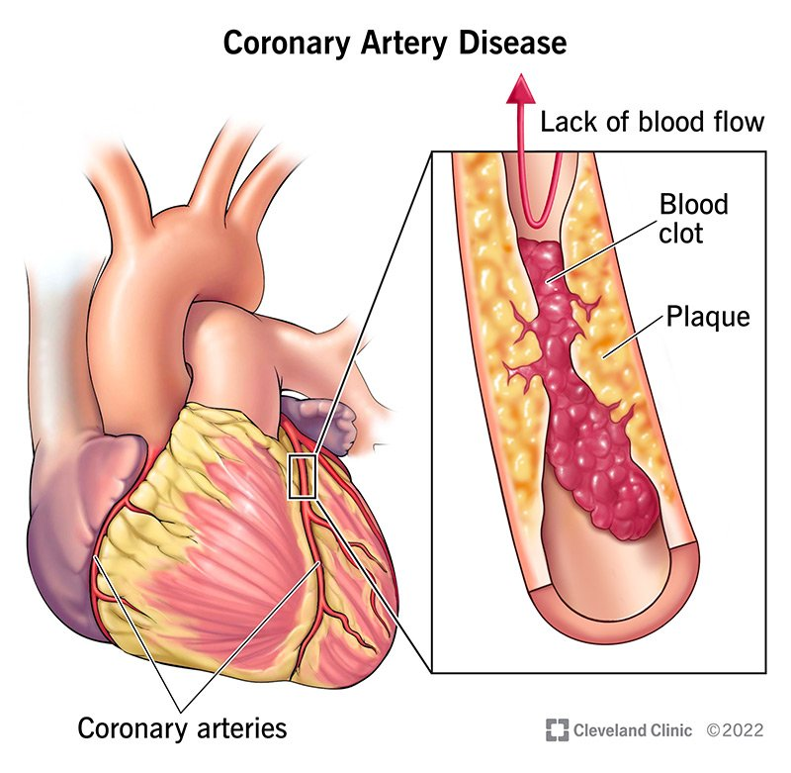
India has become heart attack hub of the world.
(Reported by thetatvaindia on 3rd October 2022)
What is chronic heart disease?
In this disease the arteries which take the oxygenated blood to the heart gets narrowed causing high BP , chest pain , heart attach , and cardiac arrest can also happen.

Slide 2
Root cause for the disease.
The most common cause of heart disease are:-
Pollution
Depression
Increased screen time
High sugar intake, high carbs in diet
Lack of exercise
Smoking
Heavy drinking(of alcohol)

